Slide 1

N- Queens using GA
Presented by : XXXXXXX
Supervised by: XXXXXXX

Slide 2
Table of Contents
N-Queens Problem
01
Genetic Algorithm
02
Results
03
Define the nature of the problem and its constraints
GA solution details
Convergence Curve

Slide 3
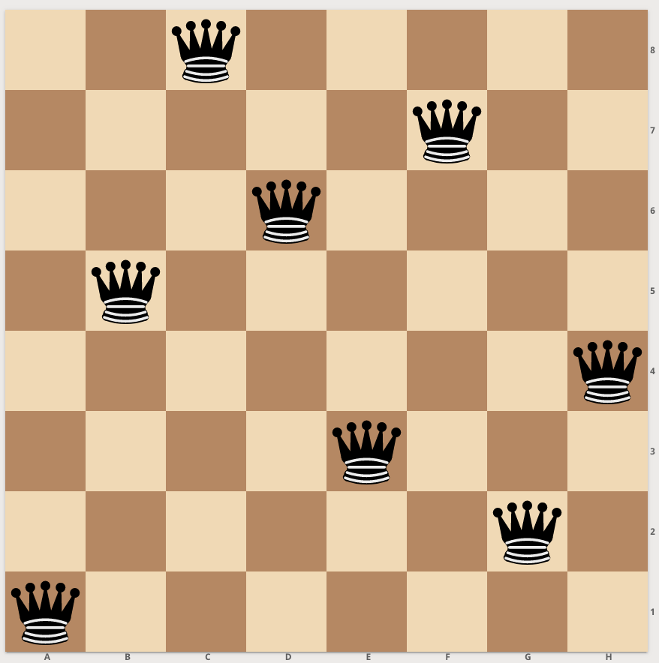
N-Queens Problem
N number of Queens are placed on NxN chess board
The solution is the placement of the N-queens in which no queen is endangered by any other queen on that chessboard
A queen can move diagonally, horizontally and vertically
The Search space is N!
Notes:
- It is an np hard problem
We can have more than one combination that satisfy all constraints:
Originally the problem is an Constraint Satisfaction problem (cs)

Slide 4
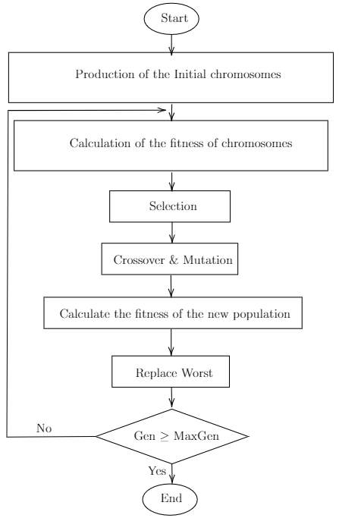
Genetic Algorithm(GA)
Genetic Algorithm
Developed in USA in the 1960’s by J. Holland, K. DeJong, D.Goldberg
The Survival of the fittest
Inspired by Charles Darwin’s theory of natural evolution
Notes:
Convert the constraints to an objective function

Slide 5
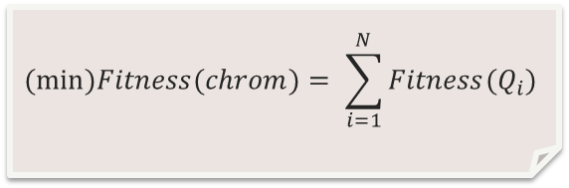
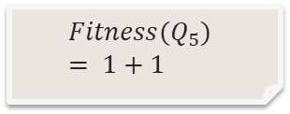
Solution Representation
Objective Function
1
2
3
4
5
6
7
8
$$Fitness(Q_{5}) = 1+1$$
Phenotype
1 | 2 | 3 | 4 | 5 | 6 | 7 | 8
$$(min⁡)Fitness(chrom)= \sum_{i=1}^{N}{Fitness(Q_{i})}$$
Genotype
8 | 4 | 1 | 3 | 6 | 2 | 7 | 5
Notes:
Permutation: means that we eliminated the possibility of having same col , or same row queens

Slide 6
Paramters Details
representation | permutations
recombination | “Cut and Crossfill” crossover
Recombination probability | 100%
Mutation | swap
Mutation | 80%
Parent Selection | Best 2 out of random 5
Survival Selection | Replace Worst
Population Size | 100
Number of Offspring | 2
Initialization | Random
Termination condition | 10,000 generation

Slide 7
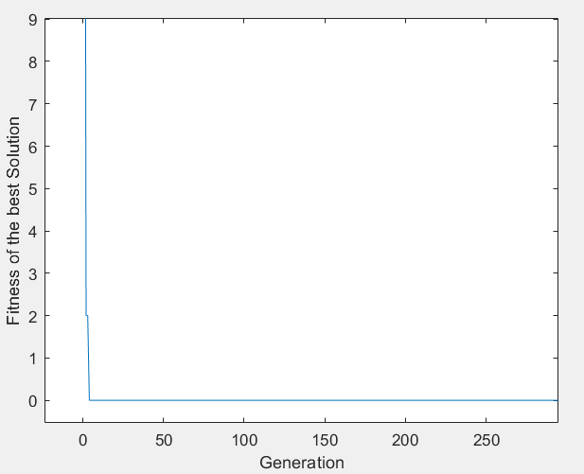
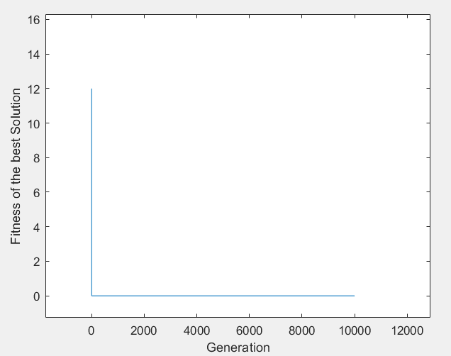
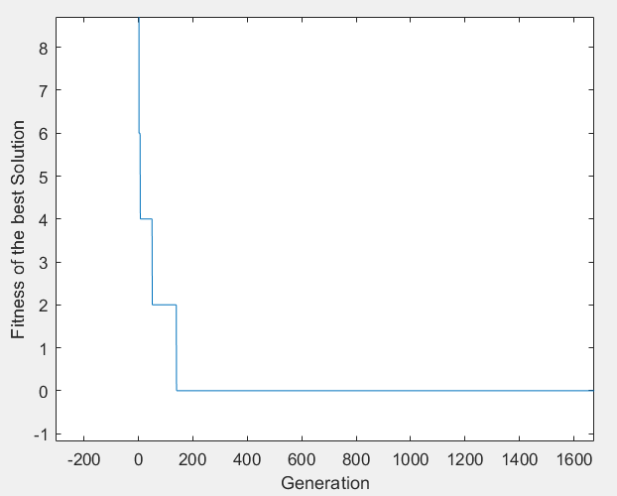
Results
8- Queens
4-Queens
16-Queens
Convergence curve graph
The solution was found within the 50 generations
The solution was found within the 5 generation
The solution was found within the 200 generations

